Slide 1

The Role of Government
2.7
Copyright Bananaomics

Slide 2

Review
Copyright Bananaomics

Slide 3
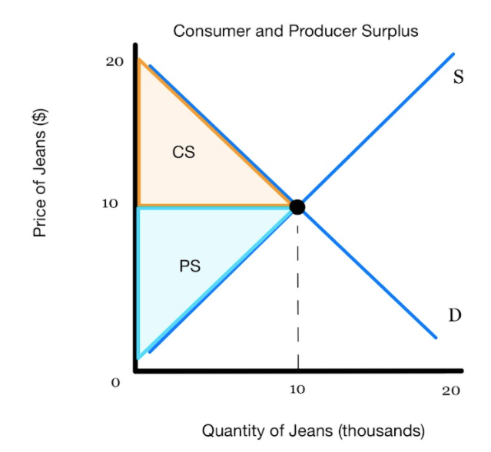
Total Surplus
Consumer Surplus + Producer Surplus = Total Surplus
Copyright Bananaomics

Slide 4
Allocative Efficiency
The ideal combination of goods and services in a society
Allocative = Distribution
Results in the MAXIMUM possible surplus - at equilibrium (Qs=Qd)
Copyright Bananaomics

Slide 5
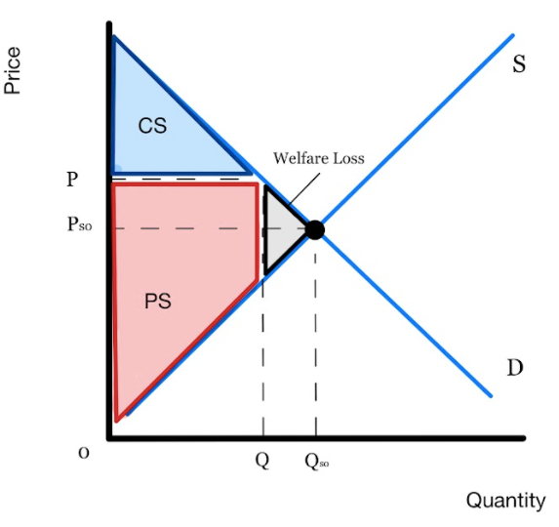
Failure of Allocative Efficiency
Failure to reach allocative efficiency results in a welfare loss.
Not producing where Qs=Qd, meaning there is a surplus lost
Copyright Bananaomics

Slide 6

Why would governments ever need to intervene in markets?
Copyright Bananaomics

Slide 7


Possible Reasons for Intervention
  To earn government revenue
  To support firms
  To support households on low incomes
  To influence the level of production
  To influence the level of consumption
  To correct market failure
  To promote equity
Copyright Bananaomics

Slide 8

  Government Revenue
Taxes
The government taxes many things DIRECTLY and INDIRECTLY such as income, VAT, etc.
Indirect Tax - a tax not aimed directly at an individual. (VAT, Sales Tax)
Direct Tax - a tax aimed directly at an individual. (Income)
Why Tax? To fund government projects and budgets.
Copyright Bananaomics

Slide 9

2. Supporting Firms
Governments like to use methods of intervention to support firms in particular industries. This can be for economic reasons, but also for political and strategic reasons.
Copyright Bananaomics

Slide 10

3. Support Low- Income Households
Supporting struggling households in order to improve the quality of life for its citizens.
Copyright Bananaomics

Slide 11




4 & 5. Influence levels of production/consumption
If a government desires more of a certain product or good in. the economy, the may offer a subsidy to increase supply/production.
Alternatively, a government may tax certain industries or products they wish to diminish such as fossil fuel companies.
The government may also diminish consumption by adding indirect taxes on certain goods that have negative effects on society such as cigarettes.
These goods are called Demerit Goods.
Copyright Bananaomics

Slide 12

6. Market Failure
Market Failure - when markets fail to allocate resources efficiently
Example
Climate Change
There is no profit to be had to combat climate change. Therefore, businesses and producers don't prioritize it. Governments may be required to step in to limit carbon emissions for the betterment of society.
Copyright Bananaomics

Slide 13

7. Equity
The Government often chooses to intervene to improve the equity of income distribution.
For example, taxing the rich and spending those tax dollars in some way to benefit low-income families an attempt to improve equity.
Copyright Bananaomics

Slide 14


Price Controls
Copyright Bananaomics

Slide 15

Price Ceiling
Copyright Bananaomics

Slide 16
Price Ceilings
When the government sets a maximum price of a good or service.
Typically used with common essential goods as services such as
  affordable housing (rent)
  low-cost food for all
Must be placed BELOW the equilibrium price in order to be effective/binding.
Can you brainstorm as to why that is the case?
Copyright Bananaomics

Slide 17
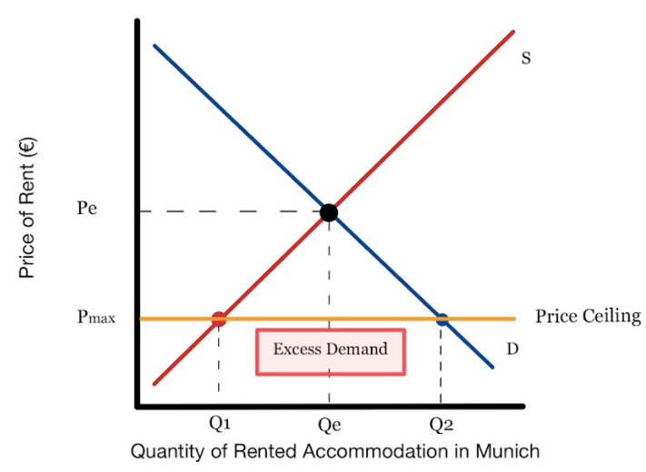
Price Ceilings
Copyright Bananaomics

Slide 18
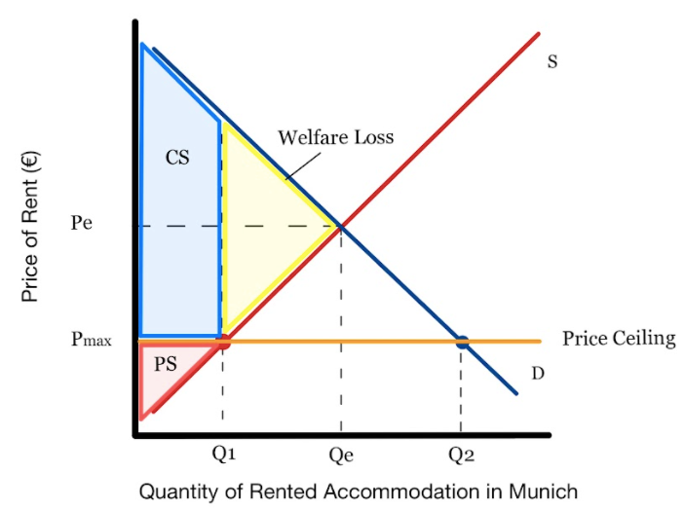
Price Ceilings
Consequences of Price Ceiling
  Shortages
  It generates a rationing problem
  It promotes the creation of parallel (illegal black) markets
  It eliminates allocative efficiency and generates a welfare loss
Copyright Bananaomics

Slide 19
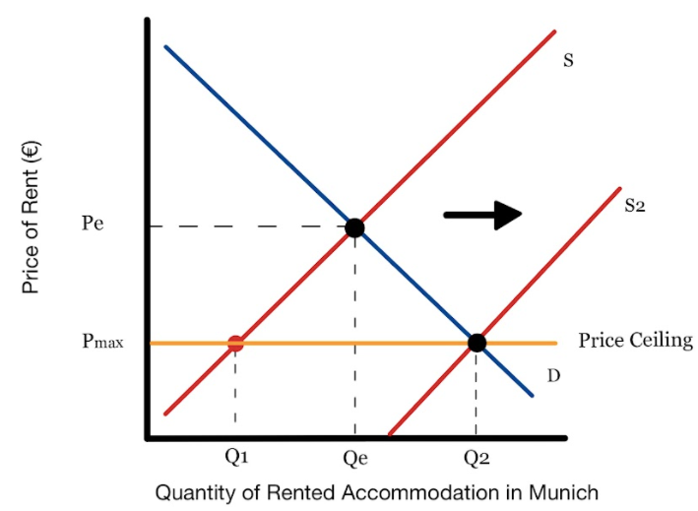
Price Ceilings
Solutions to price ceiling problems
  Increase supply
How can a government increase supply?
Copyright Bananaomics

Slide 20
Price Floor
Copyright Bananaomics

Slide 21
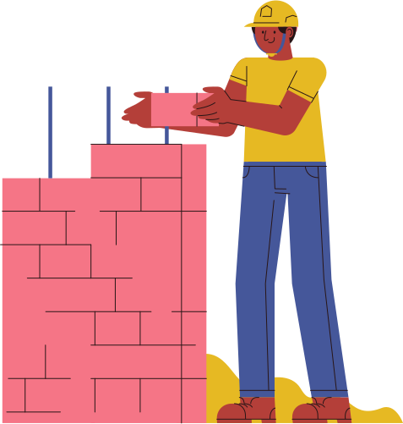
Price Floors
When the government sets a minimum price of a good or service.
Typically used to
  Protect producers that could be in danger (farmers)
  Protect workers (minimum wage)
Must be placed ABOVE the equilibrium price in order to be effective/binding.
Can you brainstorm as to why that is the case?
Copyright Bananaomics

Slide 22
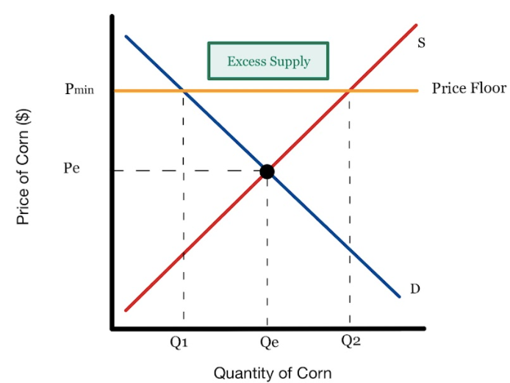
Price Floors
Copyright Bananaomics

Slide 23
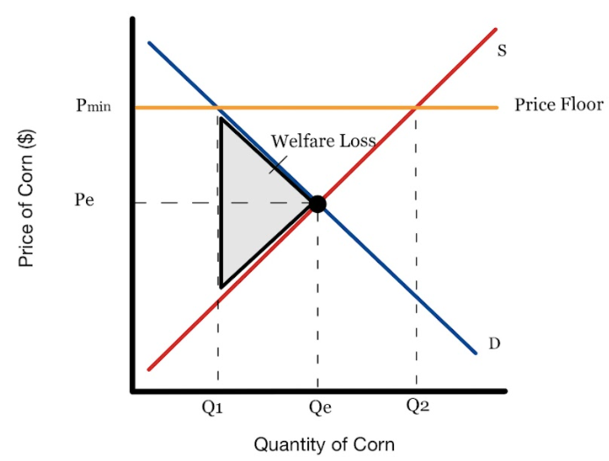
Price Floors
Consequences of Price Floor
  Surpluses
  Promotion of parallel black markets
  The government needs to dispose of surplus
  Allocative inefficient and generates welfare loss
Copyright Bananaomics

Slide 24
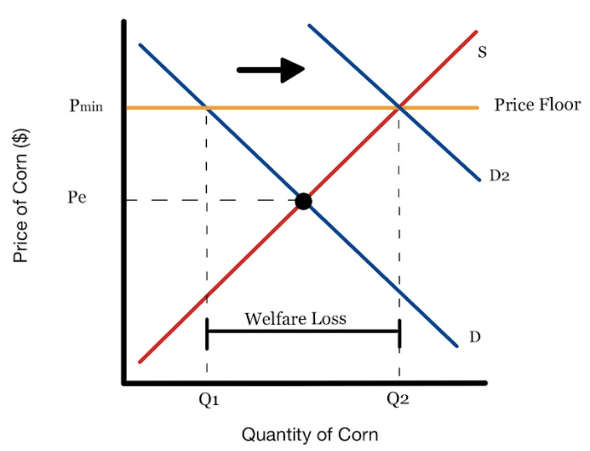
Price Floors
Solutions to price floor problems
  Government purchase of surplus (to store, to sell, donate, etc.)
    Results in large welfare loss
Copyright Bananaomics

Slide 25
Price Control Calculation
Copyright Bananaomics

Slide 26
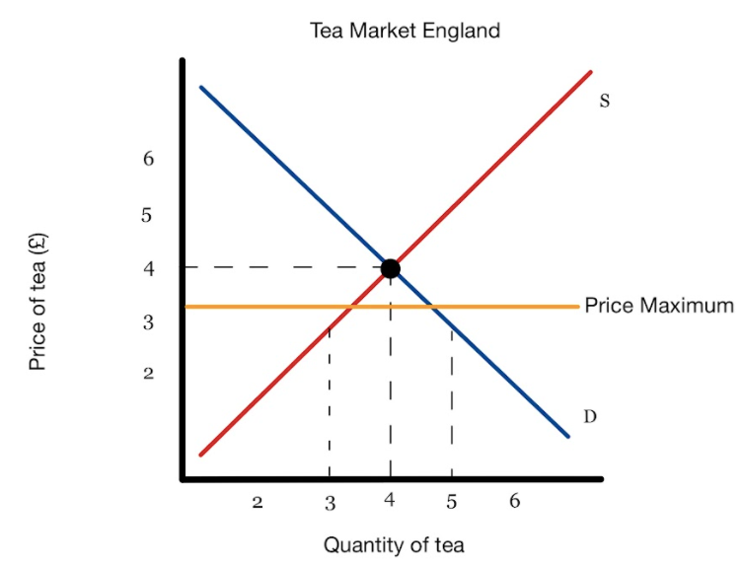

Try It Out
1. Calculate the change in producers’/suppliers’ revenue after the maximum price is set.
2. Calculate the shortage generated by the price ceiling.
Copyright Bananaomics

Slide 27
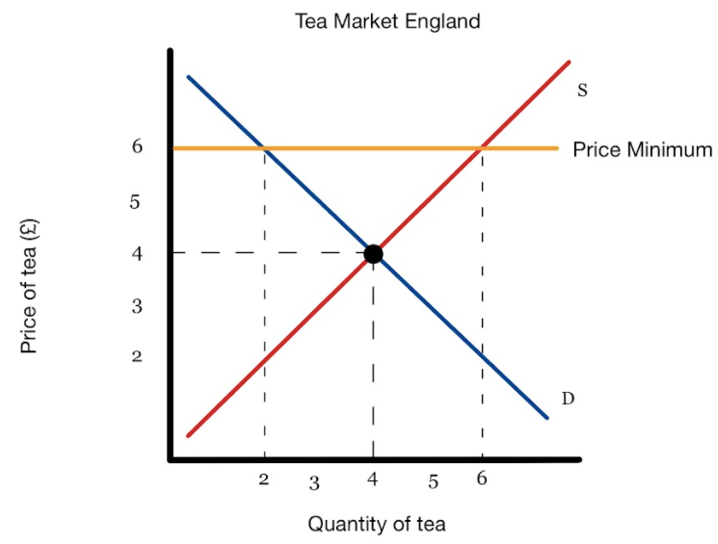
Try It Out
1. Calculate the change in firms' revenue after the price floor is set.
2. Calculate the change in consumers' expenditure after the minimum price is imposed.
3. Calculate the excess supply.
4. Calculate the government's expenditure to purchase the surplus.
Copyright Bananaomics

Slide 28



Indirect Taxes
Copyright Bananaomics

Slide 29

Why Tax?
The Aims of taxation is to
  Collect Revenue
  Discourage consumption of certain goods
  Redistribute Wealth
  Correct Allocative Inefficiencies
Copyright Bananaomics

Slide 30


Indirect Taxes
Indirect taxes are taxes not designed to target a specific individual
These taxes are also referred to as Excise Taxes
Two Types of Excise Taxes
Specific Tax
A fixed amount of tax per unit sold.
Example: For each beer sold, there is a 2 Euro Tax
Percentage Tax / Ad Valoreum Tax
A fixed percentage charged on the selling of the good.
Example: 20% on the price of cigarettes. Notice that the amount of the tax increases as purchases increase.
Copyright Bananaomics

Slide 31
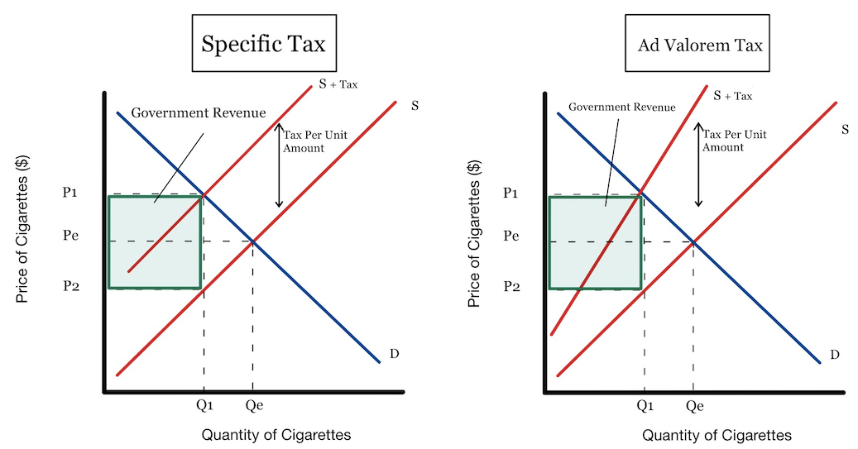
Indirect Taxes Graph
Copyright Bananaomics

Slide 32

Stakeholders
When an excise tax is introduced, what is the impact on stakeholders such as consumers, producers, government?
Answer these questions in groups or with a partner!
  What will happen to the price paid by consumers before and after tax?
  What will happen to the revenue received by producers?
  What is the situation of the government before and after tax?
  What will happen to the size of the market and what will be the subsequent effect on the workers in that market?
  Is there an effect on society as a whole?
Copyright Bananaomics

Slide 33
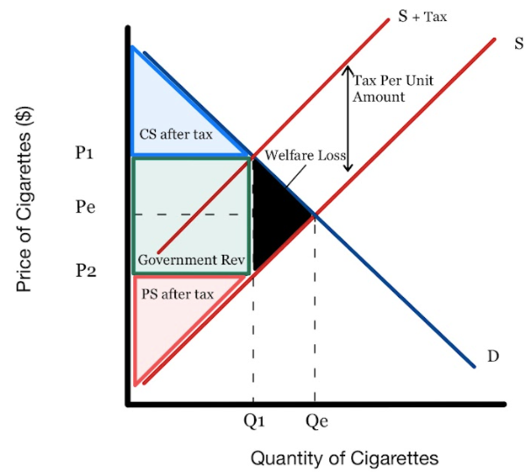
Impact on Surplus
Copyright Bananaomics

Slide 34
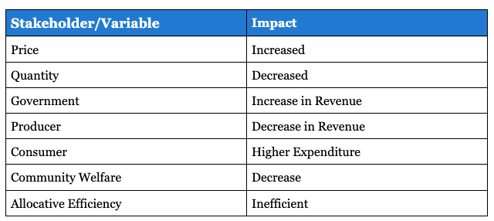
Summary of Indirect Tax
Copyright Bananaomics

Slide 35
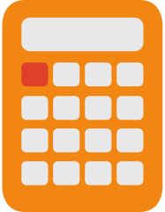
Indirect Tax Calculations
HL Only
Copyright Bananaomics

Slide 36
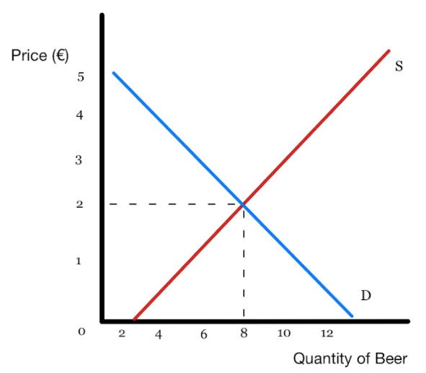

HL Only
Indirect Tax Calculation
The government has set a 2 Euro tax on beer. Draw the original equilibrium, then the change due to the tax.
Copyright Bananaomics

Slide 37
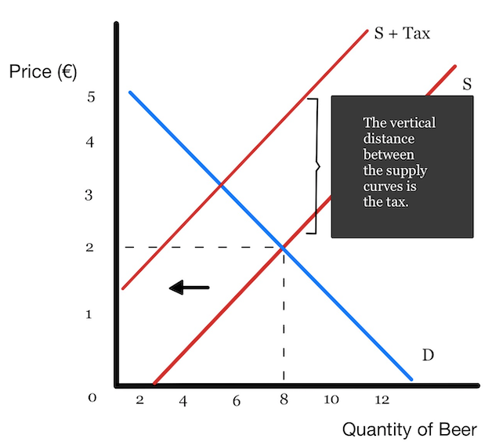
HL Only
Indirect Tax Calculation
Label the following: Consumer Surplus, Producer Surplus, Government Revenue, Welfare Loss
Copyright Bananaomics

Slide 38

Subsidies
Copyright Bananaomics

Slide 39

Purpose of Subsidies
  Increase producer revenues
  Make basic necessities more affordable
  To support the growth of a particular industry
  Encourage the consumption of a particular good or service
Copyright Bananaomics

Slide 40
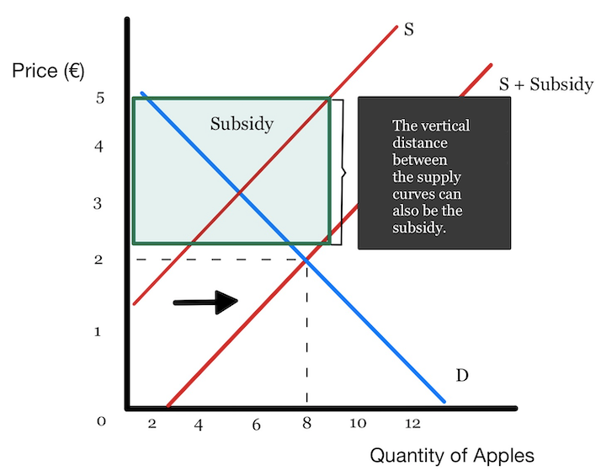
Subsidies
Copyright Bananaomics

Slide 41
Subsidies
What happens to
  The price paid by consumers
  Revenue received by producers
  Government Revenue
  Society as a whole
Copyright Bananaomics

Slide 42
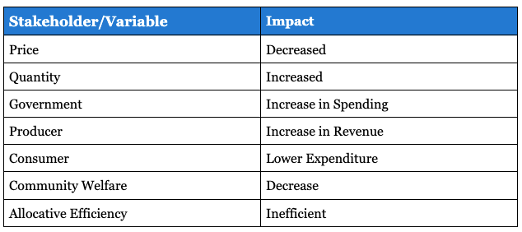
Overall Impact of Subsidies
Society As A Whole - WORSE OFF. Over-allocation of resources
Copyright Bananaomics

Slide 43


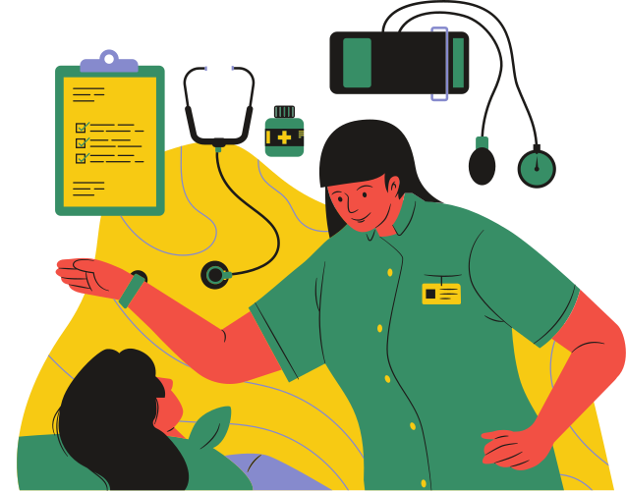

Direct Provision of Services
Copyright Bananaomics

Slide 44



Direct Provision of Services
Services Provided Directly By The Government
  Healthcare
  Public Transport
  Education
  Rail/Airline Services
  Energy
Copyright Bananaomics

Slide 45

Command, control regulation, and legislation
Copyright Bananaomics

Slide 46

Command And Control
Legislation and Regulation involve government intervention through the legal system.
Legislation - Laws set out by legislative bodies
Example: All children are required by law to go to school.
Regulation - To monitor or Regulate an industry
Examples include: BfArM or FDA, Age Restrictions, Smoking Ban
in public
Copyright Bananaomics

Slide 47
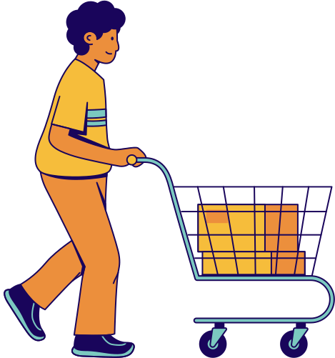
Consumer Nudges
Copyright Bananaomics

Slide 48

Consumer Nudges
Governments may use consumer nudges to correct issues or problems in the market. These nudges tend to be rather inexpensive and impactful.
Examples include:
- Organ Donation on Drivers License (Opt-out scheme vs Opt-in scheme)
- Bottle Deposit Schemes
- Electric Car Charging Stations
- Car Emissions Fees
Copyright Bananaomics

Slide 49

Practice Question
Copyright Bananaomics

Slide 50
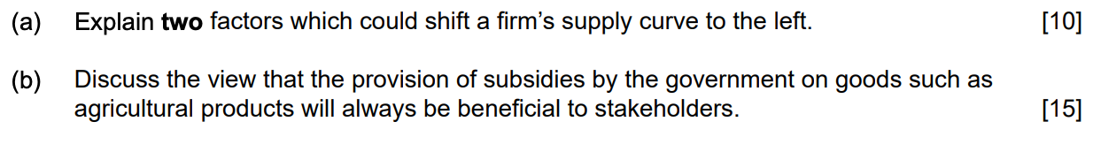
Paper 1
M19/3/ECONO/SP1/ENG/TZ2/XX
Copyright Bananaomics

Slide 51
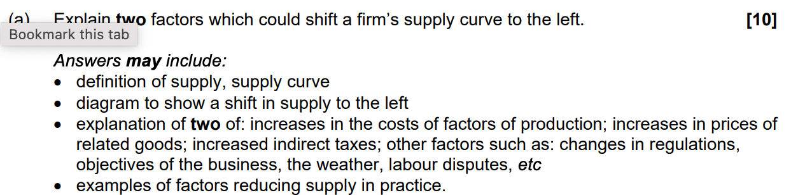
Check Answers
Copyright Bananaomics

Slide 52
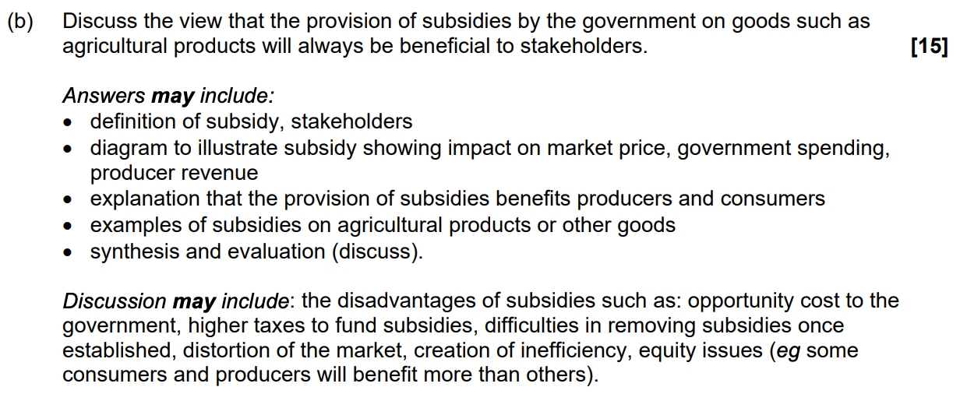
Check Answers
Copyright Bananaomics

Slide 53

Enjoying The Content?
Visit bananaomics.com to purchase package deals with discount prices!
BANANAOMICS

